Slide 1


Slide 2


Pitching Session
Autobahn
Shift to SDV
20-22 November, Karlsruhe, Germany
An Eclipse SDV Event

Slide 3

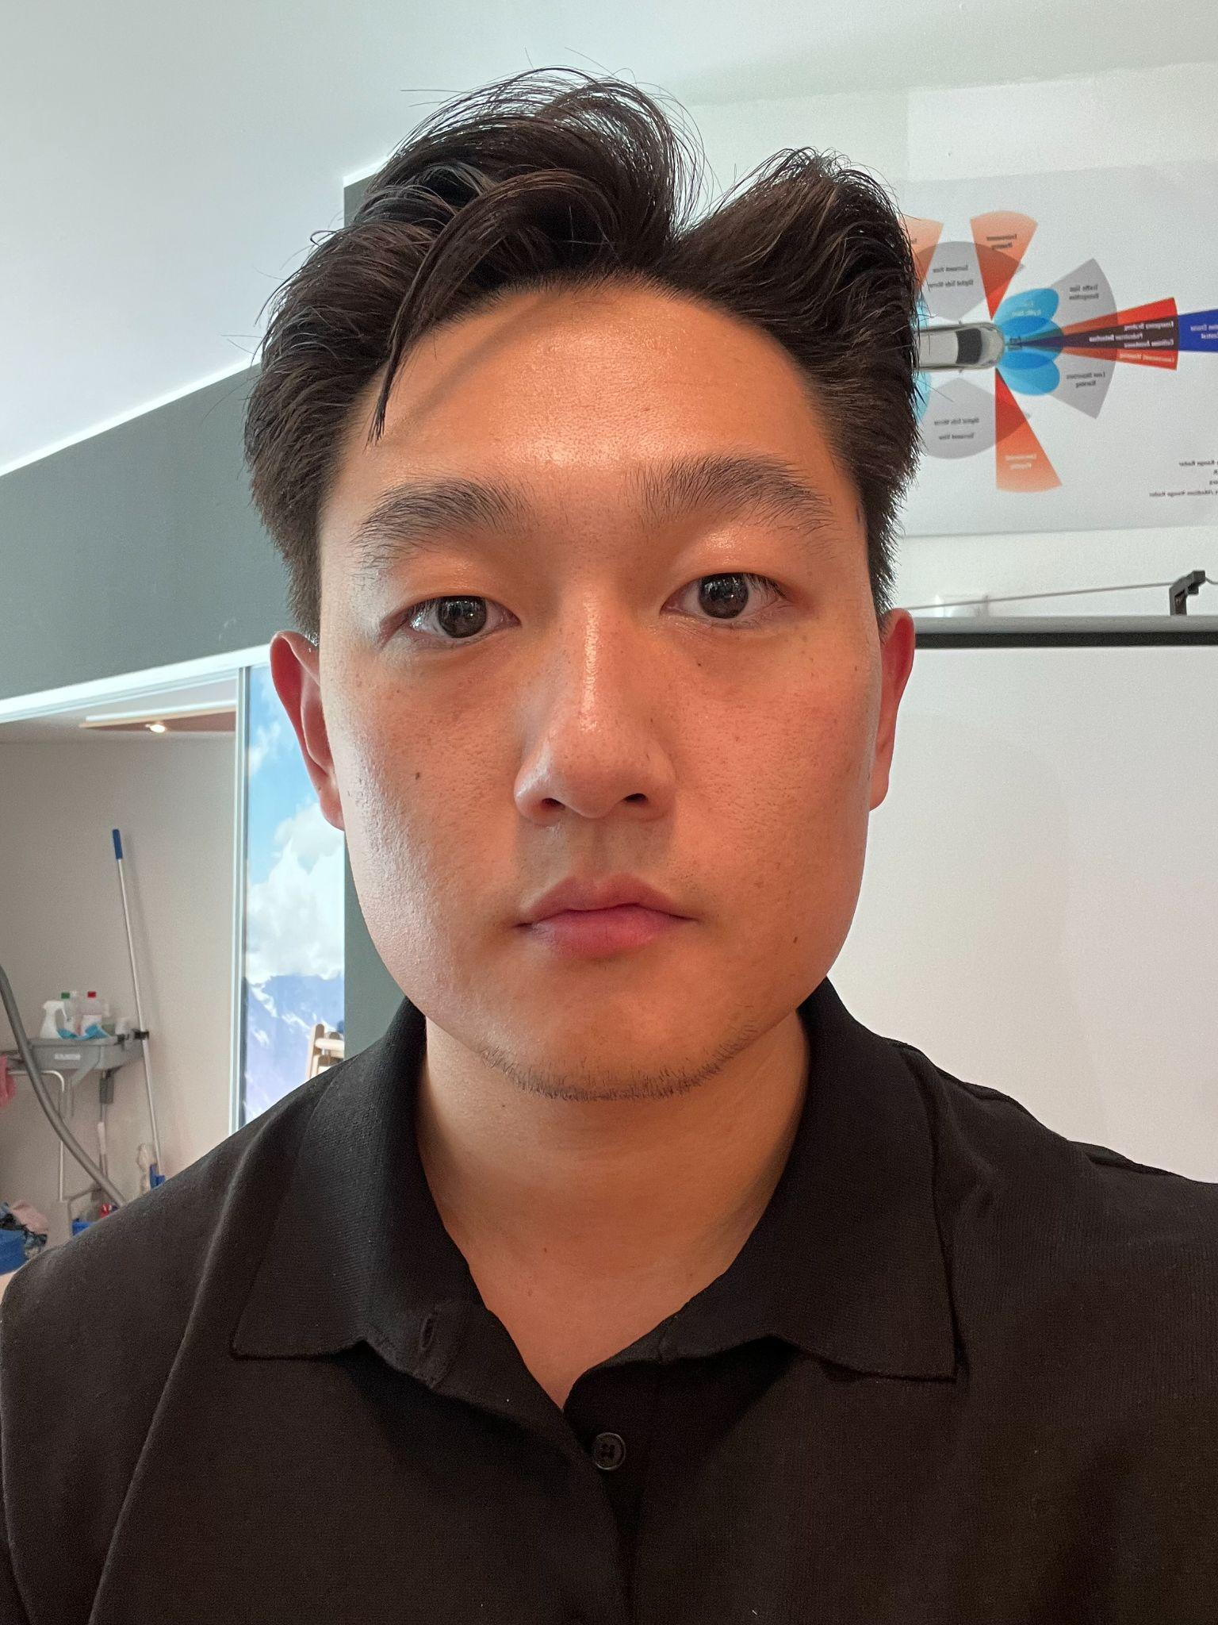
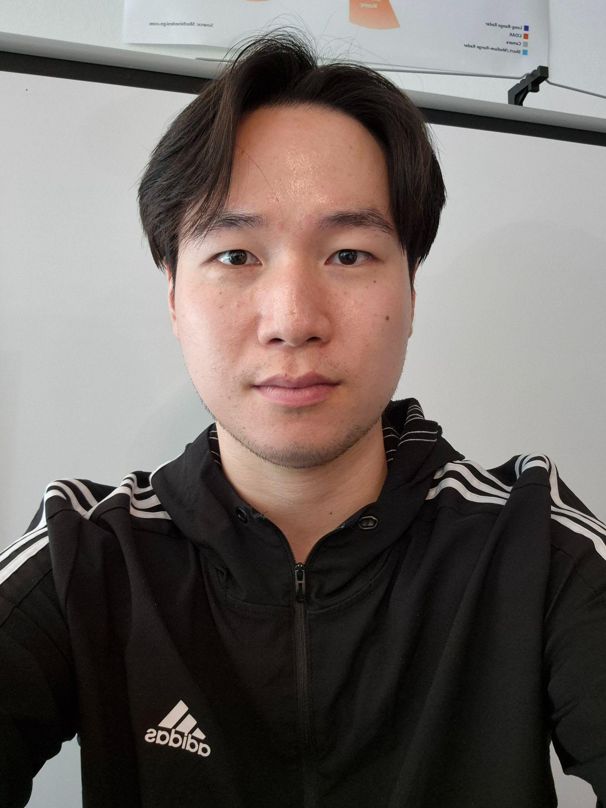
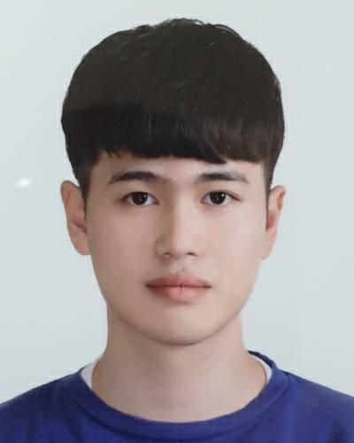


The Team
Connectivity Part
Connectivity Part
Feature
Part
Feature
Part
UI Design

Slide 4

Initial Situation
Despite vehicle numbers doubling since 2010, road traffic fatalities have decreased by 5% (WHO Global Status Report on Road Safety).

Slide 5
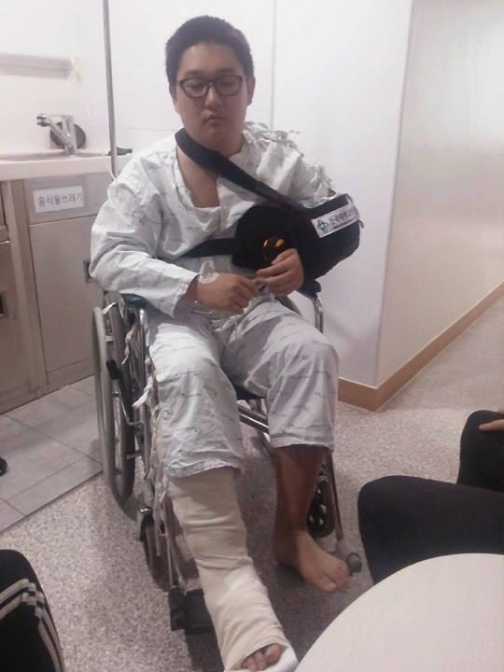
Initial Situation

Slide 6
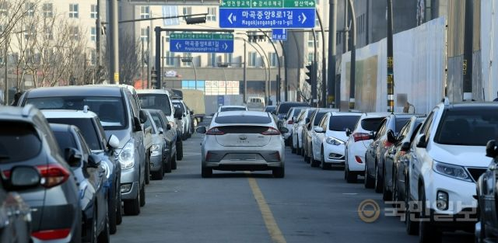
Initial Situation
A common sight on Korean roads

Slide 7
Initial Situation
Accidents caused by people emerging from behind parked vehicles

Slide 8
Initial Situation
Accidents caused by people emerging from behind parked vehicles

Slide 9
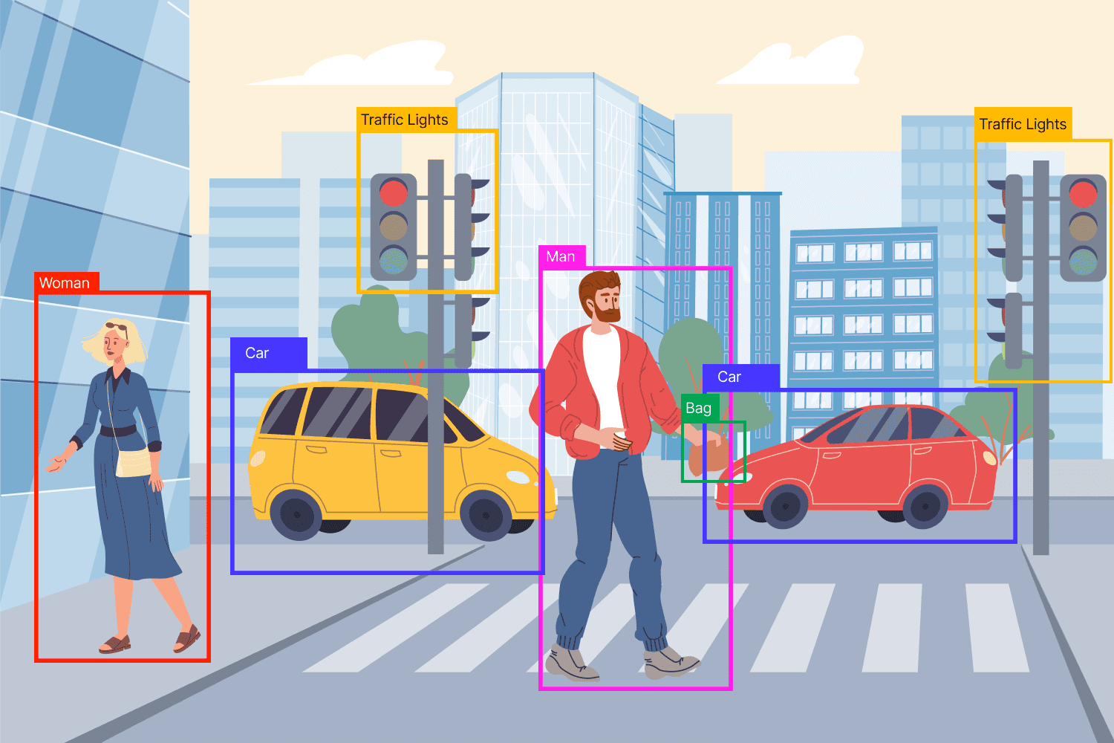
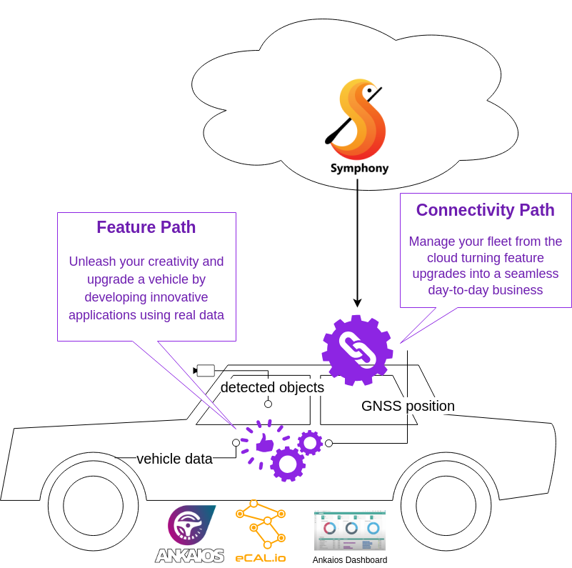

Solution(Feature Parts)

